Slide 1
Machine Learning DASC 522
Course Introduction
Dr. Torrey Wagner

Slide 2
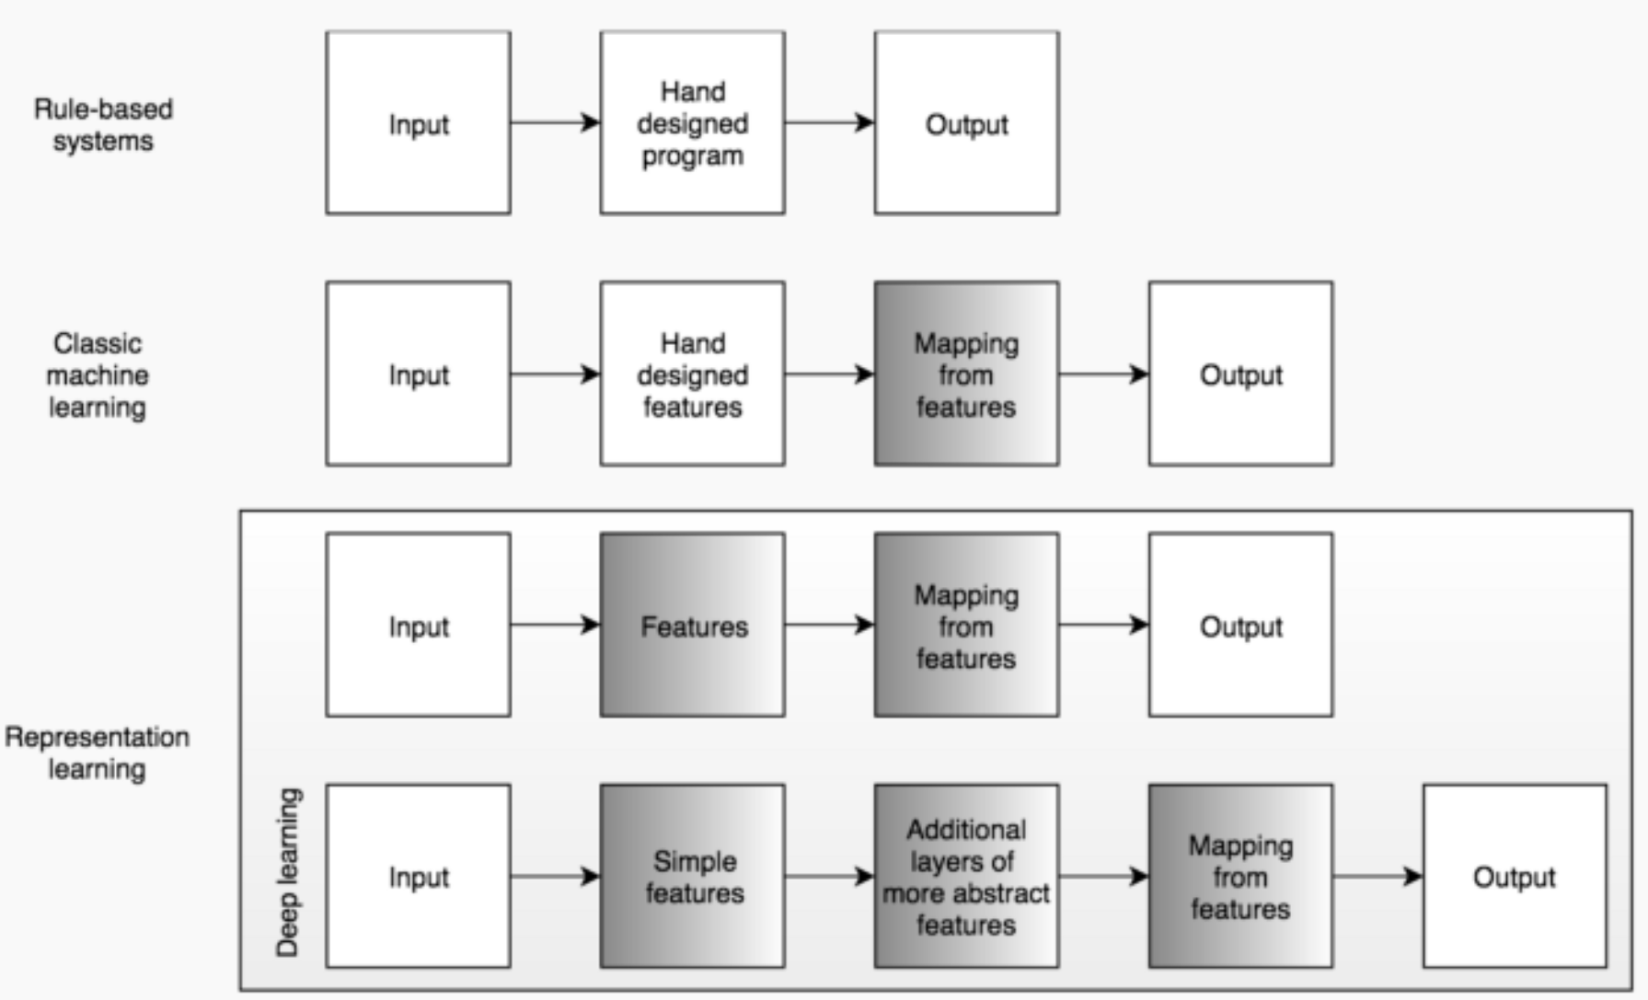
Machine Learning

Slide 3
Machine Learning
Stefan van Duin & Naser Bakhshi, Part 1: Artificial Intelligence Defined, Deloitte, 28 March 2017

Slide 4
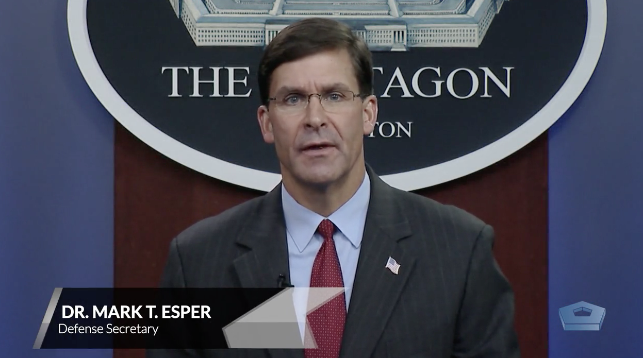
Former Secretary of Defense AI Introduction
DoD Artificial Intelligence Symposium (2020)

Slide 5
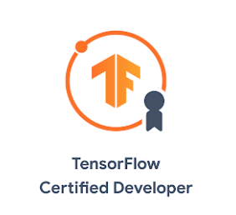
About Your Instructor
Assistant Professor – AFIT
Taught dozens of graduate courses, advised 13 master’s students
Capstone project advisor for 200+ Data Analytics certificate graduates
Many journal publications & conference papers
12+ on machine learning & agile software topics
NASIC Squadron Commander, Director of Operations
Executive Officer to the AFRL Commander
AFRL Section Chief, Branch Chief, Deputy Division Chief
AFIT PhD - EE
UK Exchange Officer w/ Systems Engineering masters
NASIC Analyst
EE undergraduate (AF ROTC)
Working with neural networks “before it was cool”
Interested in alternative energy since 2000
Fun fact: I have 9 kW of solar on my roof, and drive a 33 kWh battery-powered Ford Focus Electric, & 73 kWh Subaru Solterra

Slide 6
Course Objectives
Student Learning Objectives (SLO)
Students will thoroughly understand several machine learning processes and methods required to model data.
Students will apply machine learning processes and methods in a systematic manner to support the Air Force becoming a more data-driven organization.
Students will gain proficiency using Python to implement model building, performance assessment and the evaluation and interpretation of model results.
Students will effectively communicate technically complex ideas and concepts in both written and spoken formats.

Slide 7
Data Analytics Program Objectives
The Data Analytics Master’s degree produces graduates who possess:
Breadth. Apply foundational data analytics techniques to both improve operations and enable evidence-based decision-making for military and industrial applications.
Depth. Are well educated, highly valued, and successful data analytics professionals that continually identify and act on potential data analytic applications helping their organizations function effectively and efficiently as data-driven organizations.
Professionalism. Professionally communicate analytic solutions and results.
A passion for lifelong learning. Continue to pursue lifelong multidisciplinary learning by following, understanding, and implementing advances in the data analytics field.

Slide 8
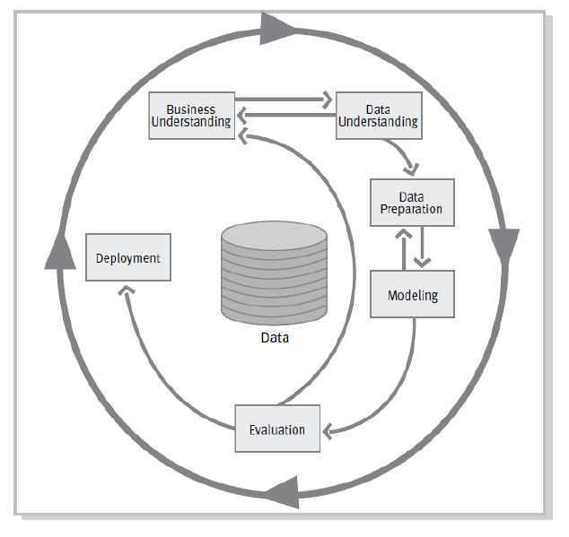
Link to Certificate Courses
DASC 500 Data Analytics
Intro to Data Analytics
CRISP-DM
Data visualization
Sample selection
Probability & statistics
Regression
DASC 501 Databases
Data Categorization
Data Types
Normalization
Indexing
Tables
Query Wizards and Select Queries
Forms
Reports
Macros

Slide 9
Link to Certificate Courses
DASC 511 OOP using Python
Programming Language Concepts
Python
Unified Modeling Language
Programming Paradigms
OOP Concepts
State and Variables
Functions
Classes
Tree and Graph Data Structures
DASC 512 - Applied Statistics using Python
Populations
Distributions
Univariate Distributions
Hypothesis Testing
Normality
Tests for Mean and Variance
Confidence Intervals
Linear Regression
R² & Model Coefficients
Interpretation
Multivariate Data
Logistic Regression

Slide 10
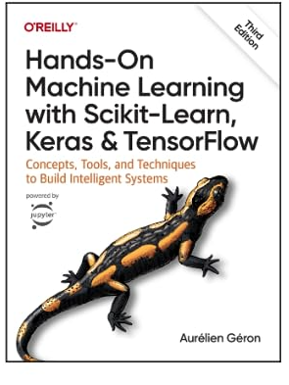
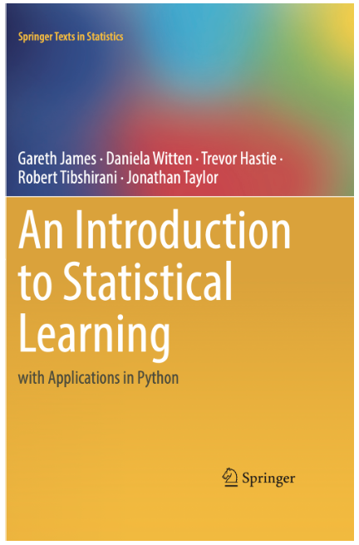
Textbook & Software
Required:
Hands-On Machine Learning with Scikit-Learn & Tensorflow, by Aurelien Geron, 3rd edition, 2023.
Introduction to Statistical Learning with Applications in Python, 2023. (free download)
.ipynb python environment

Slide 11
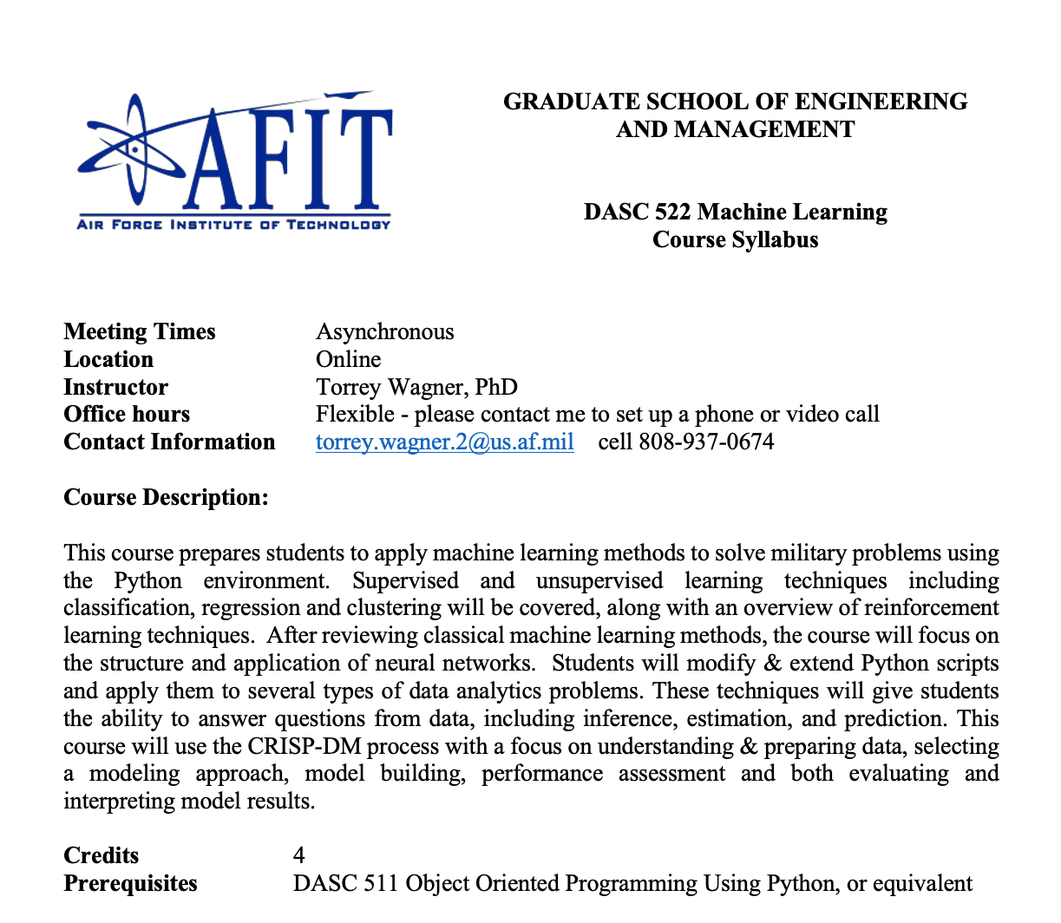
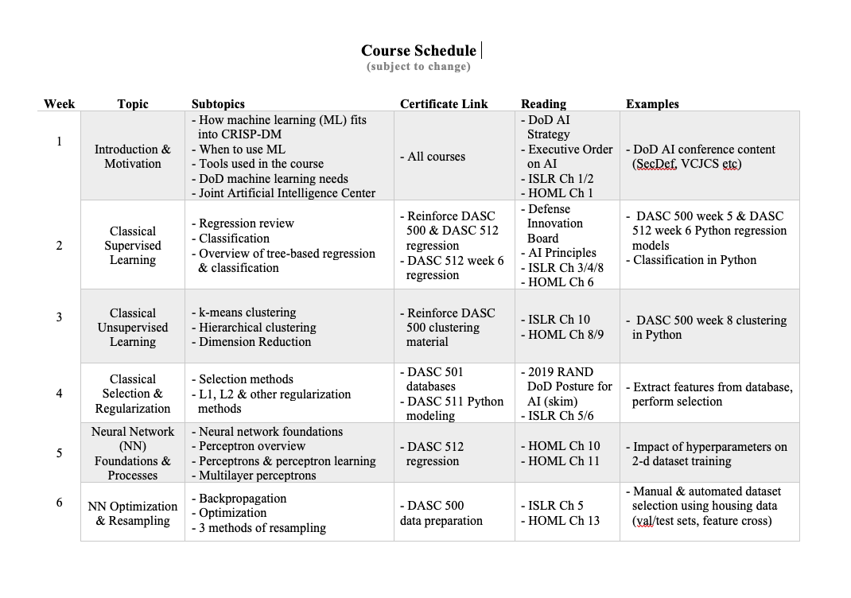
Syllabus & Schedule Review

Slide 12
Former Secretary of Defense AI Motivation
DoD Artificial Intelligence Symposium (2020)

